Slide 1
State of the Pandemic
Dr. Walensky

Slide 2
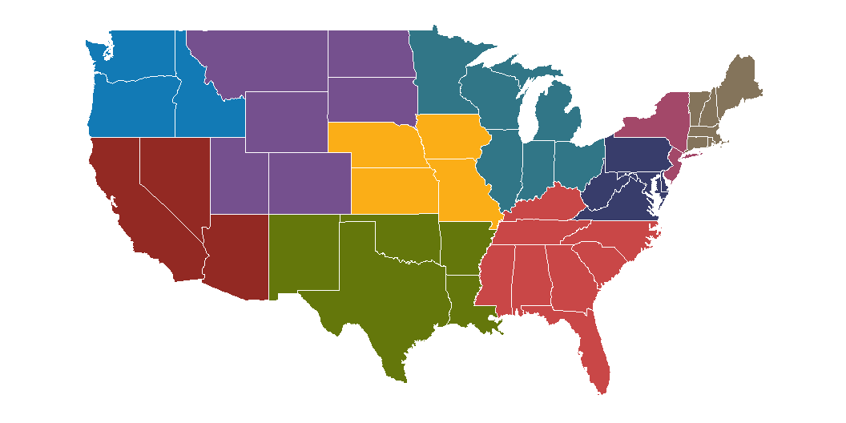

Slide 3


Slide 4
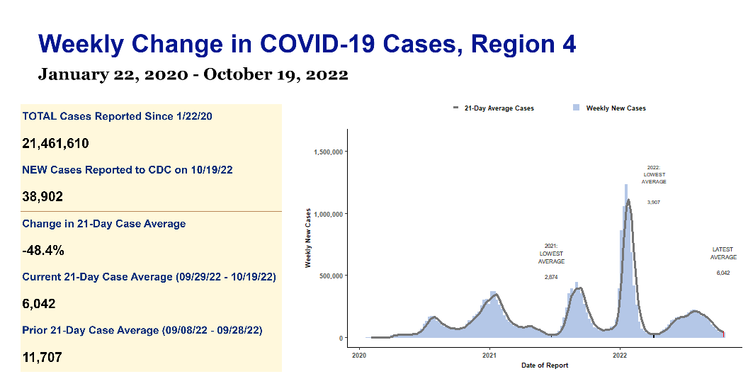

Slide 5
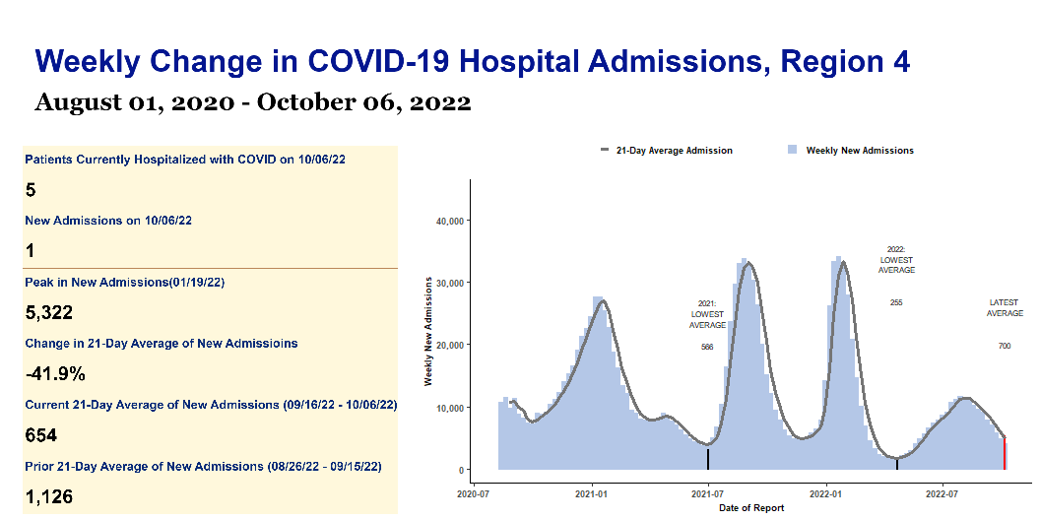

Slide 6
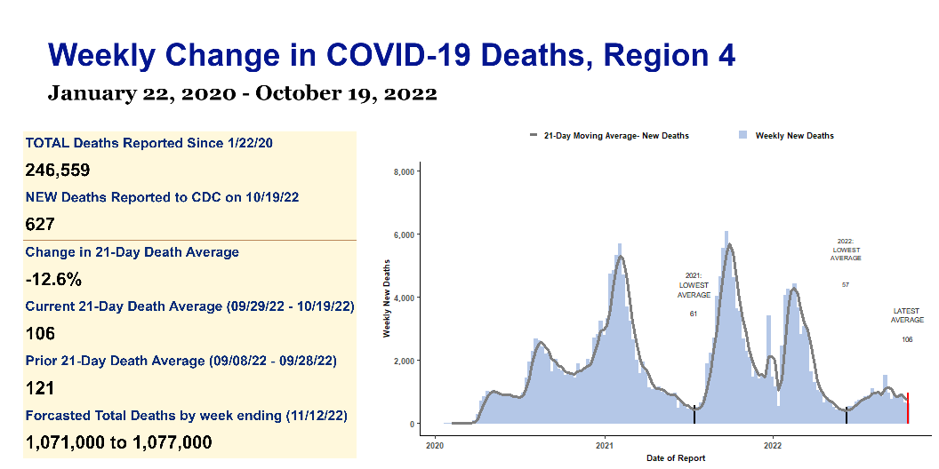

Slide 7
Region 4 Weekly COVID Report | Region 4 Weekly COVID Report | Region 4 Weekly COVID Report | Region 4 Weekly COVID Report | Region 4 Weekly COVID Report
s | s | s | s | s
Key Metrics | Key Metrics | Key Metrics | Key Metrics | Key Metrics
indicator | Total to date | Most recent week | Daily average | Period-on-period change
Cases | 21,461,610 | 38,902 | 6,042 | -48.4%
Hospital Admissions | 1,346,254 | 3,431 | 490 | -26.3%
Deaths | 246,559 | 627 | 106 | -12.6%
Test Positivity | 12.7% | N/A | 7.7% | -9.6%

